Slide 1
Line Following Robots

Slide 2
Objectives
Move in straight lines
Basic Python will be learn through examples

Slide 3
Alphabot 2
This mobile robots have only one sensor – infra red array.
black line absorb infra red while bright surface reflect infra red.
infra red travel in speed of light give almost zero delay between transmitter and receiver.

Slide 4
What you going to do in this section
https://www.youtube.com/watch?v=e3iG1YwLLdQ&list=PLFrD3-dtN05EM5r5u3bSLUqNLjTn92jNp&index=2&t=0s

Slide 5
Step by Step
All Programs -> Python -> IDLE
File -> New File

Slide 6
Test Line Tracker
from alphabot2 import motor,line_tracker
import time
# IP adddress of your robot
address = "192.168.0.100"
# create line tracker object
lt = line_tracker.line_tracker(address)
# start reading data from server
lt.start()
for i in range(100):
# stop for one second
time.sleep(1)
if lt.data==0:
continue
# lt.data is an array with 5 elements
print(lt.data)
# remember to stop the socket connection
lt.stop()
To run the code:
F5
Run -> Run Module

Slide 7
Test Motor (remember to put on floor before execution)
from alphabot2 import motor,line_tracker
import time
address = "192.168.0.100"
mot = motor.motor(address)
# below is the general function's parameters and range
# mot.command(direction,speed,duration)
# parameters:
# direction: "forward","backward","left","right","set_left_speed","set_right_speed","stop"
# speed: 0-100
# duration: second
# run forward at 20 speed for 5 seconds
mot.command("forward",20,5)
# set speed of left and right and ask robot to move forward
mot.command("set_left_speed",10)
mot.command("set_right_speed",10)
mot.command("forward")
time.sleep(5)
# stop moving , speed set to zero
mot.command("stop")
time.sleep(1)
# set speed of left and right and ask robot to move backward
mot.command("set_left_speed",10)
mot.command("set_right_speed",10)
mot.command("backward")
time.sleep(5)
mot.command("stop")
time.sleep(1)
# spin turn
mot.command("set_left_speed",10)
mot.command("set_right_speed",10)
mot.command("left")
time.sleep(5)
mot.command("stop")
time.sleep(1)
# spin turn
mot.command("set_left_speed",10)
mot.command("set_right_speed",10)
mot.command("right")
time.sleep(5)
mot.command("stop")
# remember to stop the socket connection
mot.stop()

Slide 8
Let’s imagine how this robot see

Slide 9
Let’s talk about calibration
Notes:
use the average / mean as threshold

Slide 10
Let’s Talk about Rules
forward
left
right
u-turn
stop

Slide 11
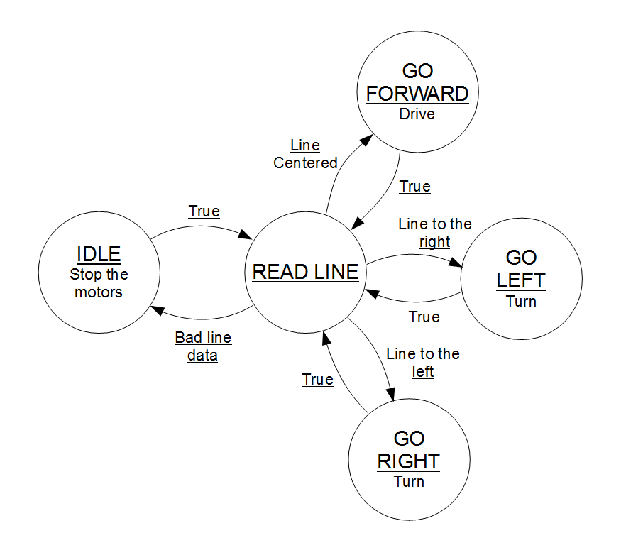
Let’s Write down all the rules!
Write down or draw your rules in a pieces of paper
use while loop
use for loop
use if else condition
Notes:
L

Slide 12
Let’s program it!
I will help you on translating your writing to code

Slide 13
Demonstrations

Slide 14
Any Questions?

Slide 15
My Questions
Q1: Does the robot know whether it is moving after you give it a command?
Q2: How to let robot know whether it is moving after you give it a command?
Q3:
Q4: How many combination of IR sensors available?
Q5: How many combination of an Image pixel available? Assume a 640x480x3 image with 256 color
Notes:
Q1 No
Q2 another sensor, vision, encoder,
Q3
Q4 2**5
Q5 see next page

Slide 16
(480*640*3)**256
837,281,154,554,675,803,056,768,500,736,983,413,910,406,255,272,797,282,366,395,940,521,808,788,471,851,456,991,730,028,084,400,538,285,605,116,792,946,575,001,658,602,639,467,536,509,614,247,890,076,307,712,377,001,308,643,254,548,624,151,470,638,133,756,358,629,842,711,217,155,177,826,861,586,655,565,861,327,887,517,895,375,491,141,985,443,931,745,905,345,425,282,038,366,283,194,007,772,414,677,787,203,722,158,591,439,966,820,147,606,510,473,801,911,742,010,431,250,382,687,049,447,445,608,247,978,001,065,610,771,910,401,153,309,408,136,704,501,557,801,525,240,577,104,646,953,298,885,863,995,734,505,900,244,286,281,305,089,053,120,255,399,275,991,484,048,367,016,502,303,659,127,219,734,928,419,058,041,893,287,347,154,818,772,455,729,056,388,483,275,021,418,827,432,080,789,510,345,955,767,089,002,237,187,838,167,336,910,926,400,265,941,211,641,179,205,684,857,271,870,227,438,015,297,550,902,574,157,546,549,550,947,686,098,510,211,567,829,845,033,484,365,298,637,890,383,043,535,938,924,373,275,555,767,812,847,797,387,459,542,733,573,689,565,859,949,163,581,193,461,086,252,133,000,942,959,713,334,572,289,790,414,025,833,784,903,421,035,792,265,047,407,658,554,702,206,457,563,851,356,281,583,171,027,248,488,789,100,052,703,643,341,415,424,360,478,349,108,944,801,562,630,812,415,559,224,621,994,905,211,195,007,088,439,755,036,793,241,600,000,000,000,000,000,000,000,000,000,000,000,000,000,000,000,000,000,000,000,000,000,000,000,000,000,000,000,000,000,000,000,000,000,000,000,000,000,000,000,000,000,000,000,000,000,000,000,000,000,000,000,000,000,000,000,000,000,000,000,000,000,000,000,000,000,000,000,000,000,000,000,000,000,000,000,000,000,000,000,000,000,000,000,000,000,000,000,000,000,000,000,000,000,000,000,000,000,000,000,000,000,000,000,000,000,000,000,000,000,000,000,000,000,000,000,000,000,000,000,000,000,000,000,000,000,000,000,000,000,000,000,000,000,000,000,000,000,000,000,000,000,000,000,000,000,000,000,000,000,000,000,000,000,000,000,000,000,000,000,000,000,000,000,000,000,000,000,000,000,000

